Slide 1
HemTools Tutorial

Slide 2
Outline
Software overview
General principles
Examples
ATAC-seq
ChIP-seq
CUT & RUN
CRISPR-seq

Slide 3
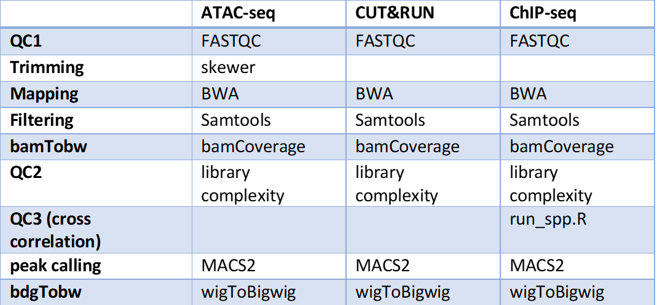
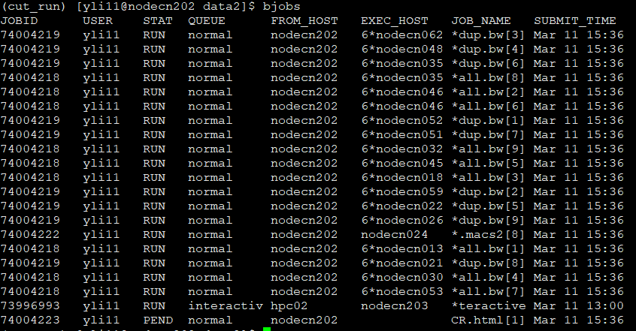
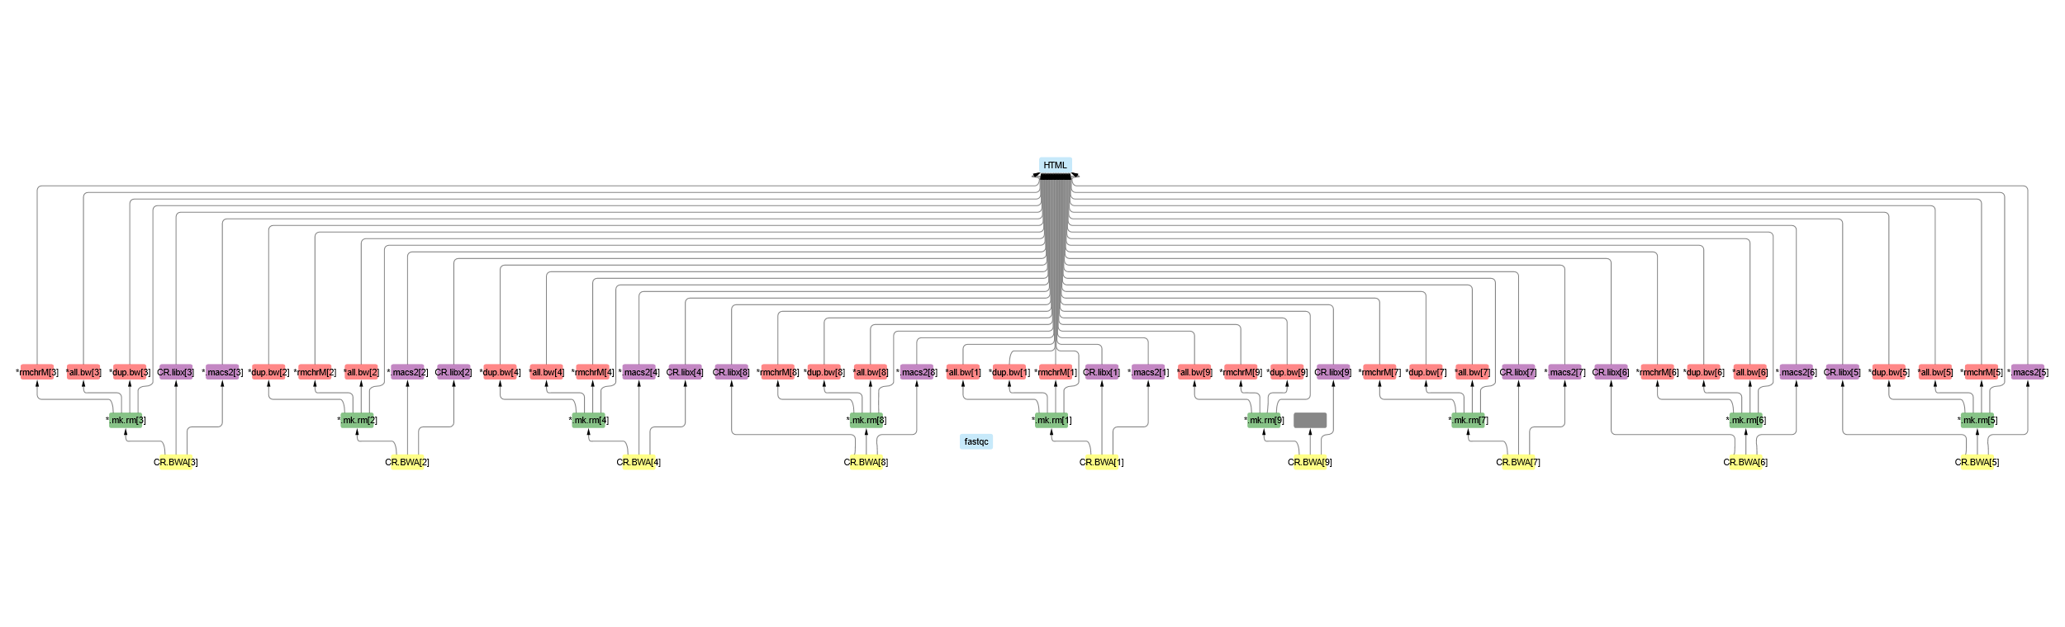
Software overview
Minimizing computation time
A tree of jobs

Slide 4
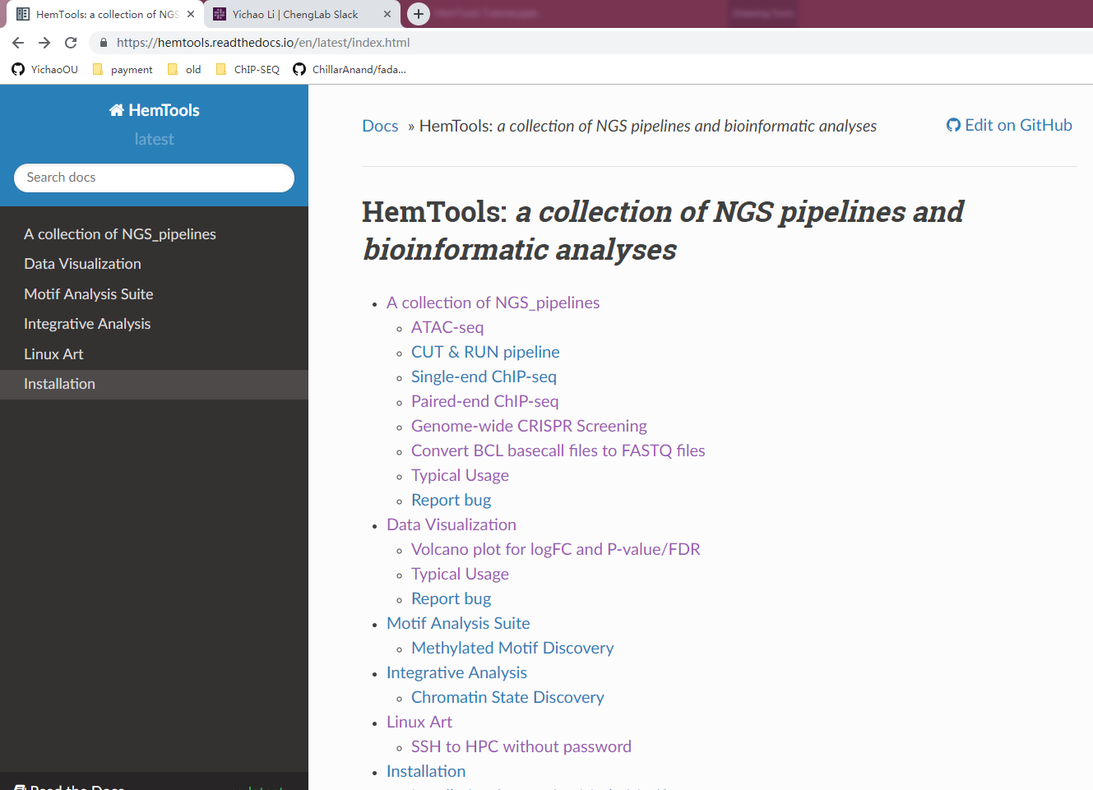
Software overview
Minimizing computation time
A tree of sub-jobs
Creating user-friendly interface
Online documentation
https://hemtools.readthedocs.io

Slide 5
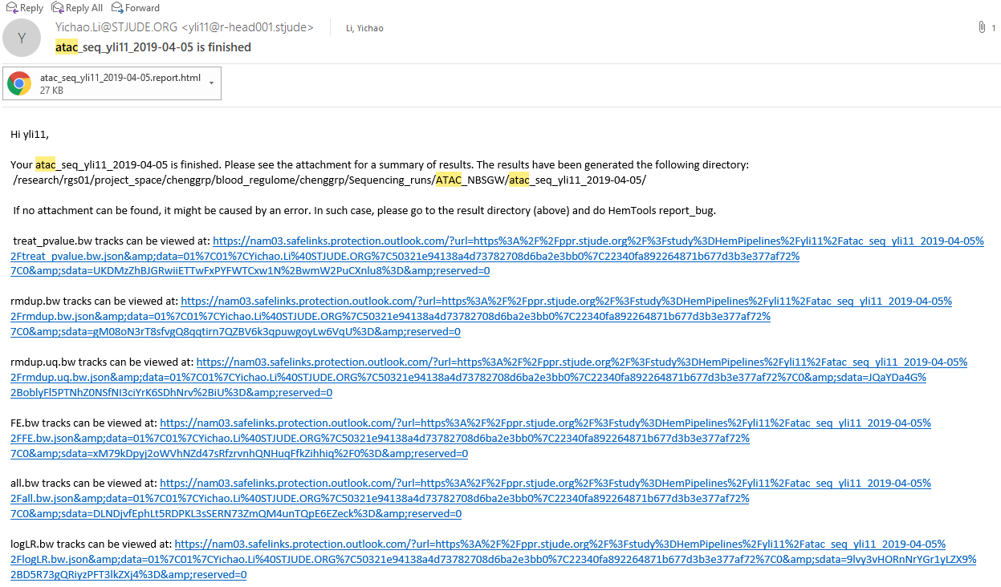
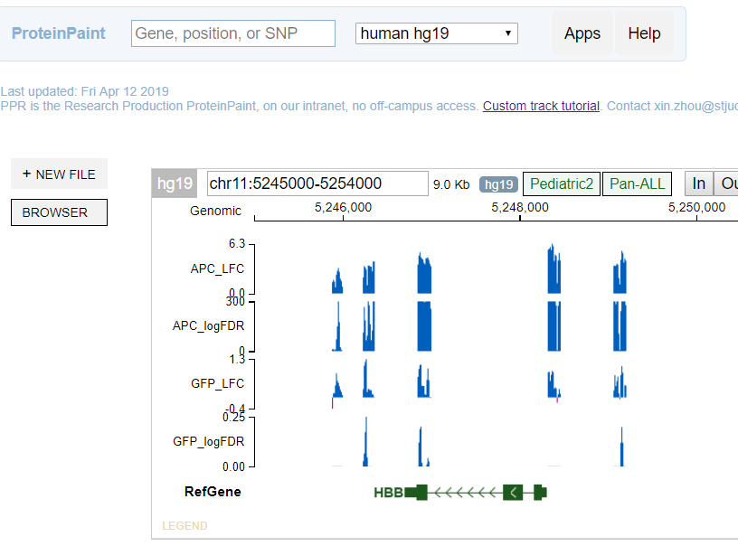
Software overview
Minimizing computation time
A tree of sub-jobs
Creating user-friendly interface
Online documentation
https://hemtools.readthedocs.io
Email notification system
Bug/Error notification system
Visually-appealing reports

Slide 6
Software overview
Minimizing computation time
A tree of sub-jobs
Creating user-friendly interface
Online documentation
https://hemtools.readthedocs.io
Email notification system
Bug/Error notification system
Visually-appealing reports
Reducing user’s mental effort
Free of installation
Simple input files preparation

Slide 7
General principles
Command format
HemTools subcmd some_required_parameters
HemTools atac_seq -f fastq.tsv
HemTools cut_run -f fastq.tsv -d peakcall.tsv
HemTools chip_seq_single -f fastq.tsv -d peakcall.tsv
HemTools chip_seq_pair -f fastq.tsv -d peakcall.tsv
Subcmd is case-insensitive

Slide 8
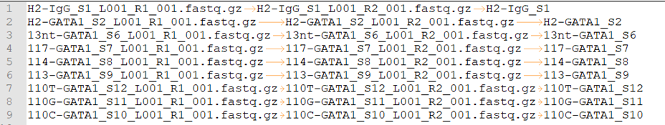
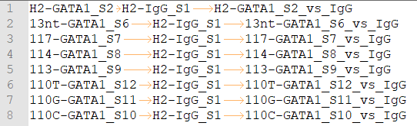
General principles
Command format
HemTools atac_seq -f fastq.tsv
HemTools cut_run -f fastq.tsv -d peakcall.tsv
HemTools chip_seq_single -f fastq.tsv -d peakcall.tsv
HemTools chip_seq_pair -f fastq.tsv -d peakcall.tsv
Input format (tsv, tab-separated values)
-f, --input
-d, --design_matrix

Slide 9
General principles
Output format

Slide 10
General principles
Report bugs

Slide 11
Materials
Handouts
Questionnaire
Online doc
Terminal
Ppt

Slide 12
Software requirements analysis
Adapting and automating previous pipelines
Minimizing computation time
Creating user-friendly interface
Online end-user documentation
Email notification system
Bug/Error notification system
Visually-appealing reports
Reducing user’s mental effort
Free of installation & ready to use
Simple input files preparation
Easy search for appropriate APIs

Slide 13
Linux 101

Slide 15
CUT & RUN example

